Slide 1

Hands-On Symposium on
ARC communication and interoperability
08.04.24 - 10.04.24

Slide 2


Thank you DB
Vroom vroom

Slide 3
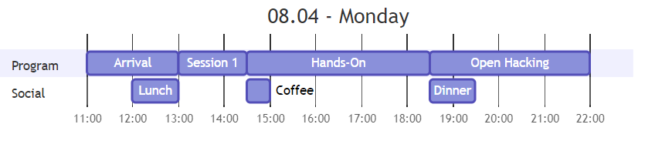
Monday - First session
1PM– 2:30PM
Introduction to ARC, RO-Crate & ARCtrl

Slide 4
Hands-On
Discussions about specification and implementation
Proof of principle coding

Slide 5
Open Hacking
Is actually meant as open hacking!
Roam freely as you like, room will be kept open depending on demand

Slide 6
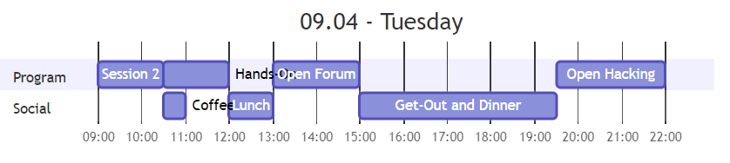
Tuesday - Second session
9AM – 10:30AM
Progress reports
Answer the following questions
How is the task connected to ARC?
What ARC related tooling did you use?
What gain did you draw from the process model?

Slide 7
Tuesday - Open forum
1PM – 3PM
Feel free to write questions on the board
What do you want from the ARC?
What tooling do you need?

Slide 8


Tuesday - Hike
3PM – 5:30PM
~5km and 200m of altitude

Slide 9
ARC & RO-Crate
H. Lukas Weil

Slide 10


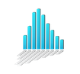


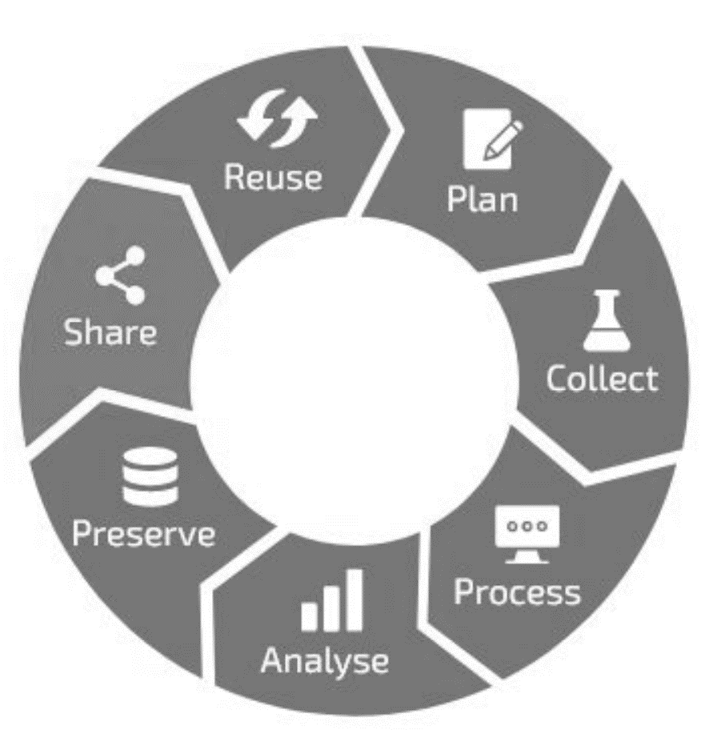
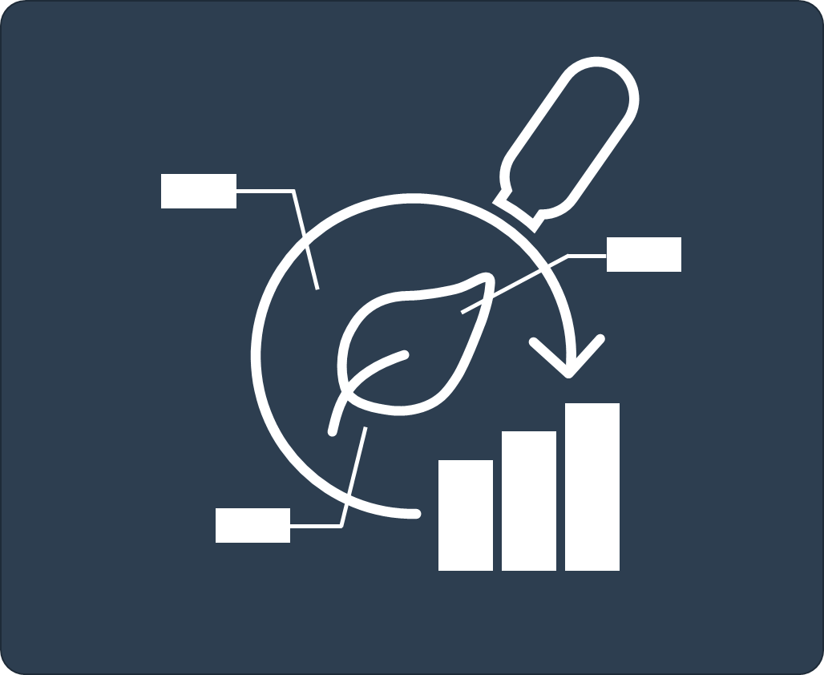





Research metadata need to be actionable to create user benefit
EBI: MetaboLights
specializes endpoints
dataset search
data publication
Notes:
Todo: - Wenn wir andere als Google haben auch hinzufügen - Hier kurz erwähnen, dass wir ein FDO namens ARC entwickelt haben, welche bei richtiger Nutzung die verschiedenen Ebenen von FAIR erfüllt
- Unique-Moment -> ARC füllt die Gap zwischen Standards, Repositorien und der unübersichtlichen FDM-Welt
- Das ist dadurch begründet, dass ARC zu allen Seiten offen und dadurch einfach zu integrieren ist > Standards rein (kommt später noch) und Integrierbarkeit raus (Repos aber auch datenspezifische Zwischentools wie beispielsweise OMERO)
- Vll hier auch kurz Templates erwähnen

Slide 11


Requirements for actionability in FDOs
?
Only consistently structured data can be consistently acted on

Slide 12
Requirements for actionability in FDOs
Identification and specification of shared patterns allows the reuse of valuable developer time

Slide 13
Ontology driven modelling
semantics
semanticized structure
structure
+
ontology
property
key
value
property
property
[
[
[
[
object
property
object
property
“complex” object model
“complex” object model
Basing specifications on predefined concepts increases shared interpretability

Slide 14


Mixing multiple semantic sources with structure
container ontology
bio & tech ontologies
…
isa
Entities stemming from container ontologies can be further characterized using domain specific knowledge source

Slide 15
Separability of research elements
Separability and redundant patterns allow reusability of programmed actions

Slide 16
Separability of research elements
observable
sample
data
Process model
Hierarchical object
Separability of research elements
Notes:
Process model allows for separation of research elements. Experts in different stages of the research can focus their attention on specific processes and the participating entities. E.g. first step from observable to sample (next slide)

Slide 17
ISA abstract model in a nutshell
isa
Investigation:
administrative metadata
Person
Publication reference
Study:
administrative metadata
Experimental context
Person
Publication reference
Assay:
Technology context
has (many)
has (many)

Slide 18
ISA & CWL Model: Study
protocol / workflow
[ ]
process
*
[ ]
optional
observable
parameters
sample
characteristics
Studies contain processes and contextualizing metadata for the experimental steps starting with the observable and ending with the sample
isa

Slide 19
ISA & CWL Model: Assay
protocol / workflow
[ ]
process
[ ]
optional
sample
parameters
sample/ data
data
characteristics
Assays contain processes and contextualizing metadata for the experimental steps starting with a sample and ending with data
isa

Slide 20
ISA & CWL Model: Run
computational workflow
[ ]
*
[ ]
process
[ ]
optional
data
parameters
data
data
characteristics
Runs contain computational processes (i.e., workflows) and contextualizing metadata for the computational steps starting with data and ending with derived data

Slide 21
ISA & CWL Model: Annotation principle
study
study
sample (b)
observable (b)
observable (a)
sample (a)
protocol
assay
sample(s)
protocol
Edges: process
Nodes: sample/ observation
Subgraph: dataset
protocol
data
Processes model the flow of information from input to output entities

Slide 22


ARC is a real-world RO Crate implementation
dataset entry
isa
ZIP
ZIP
ISA and CWL model adds practical usability on top of “raw” Crates

Slide 23
JSON-LD 101
{
"@id": "#112,572,258,540",
"@type": "Person",
"firstName": "Heinrich Lukas",
"lastName": "Weil",
"money": "~infinite IRR"
}
+
=
{
"@context": {
"sdo": "http://schema.org/",
"Person": "sdo:Person",
"firstName": "sdo:givenName",
"lastName": "sdo:familyName",
"money": "sdo:netWorth"
}
}
JSON-LD contextualizes (and links) json
https://worldpopulationhistory.org/my-population-number/

Slide 24
RO-Crate 101
<RO-Crate root directory>/
ro-crate-metadata.json # MUST
ro-crate-preview.html # MAY
ro-crate-preview_files/ # MAY
[payload files and directories] # 0 or more
=
ZIP
RO-Crate contextualizes and bundles data
https://www.researchobject.org/ro-crate/1.1/structure.html

Slide 25
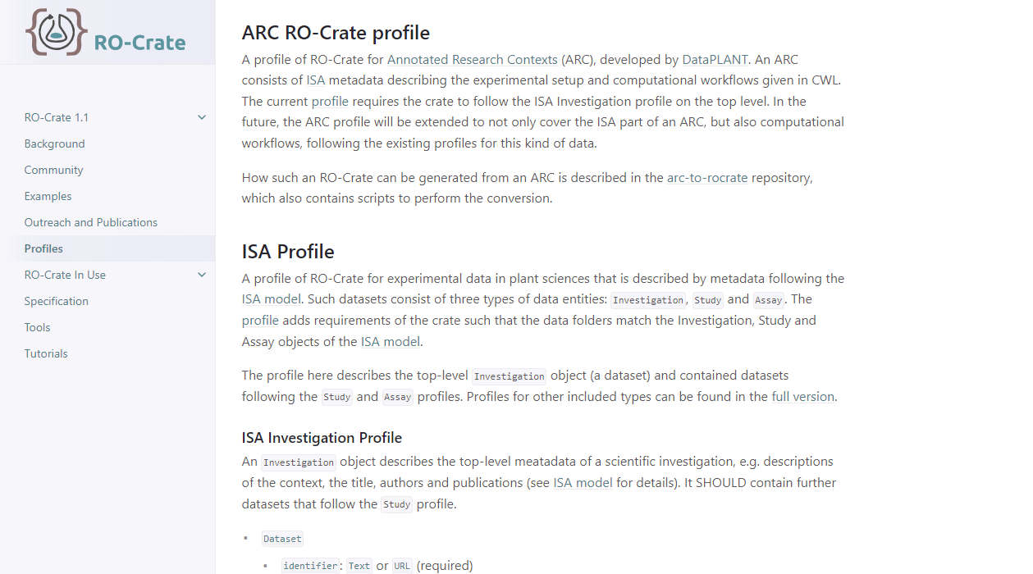
ARC RO-Crate

Slide 26
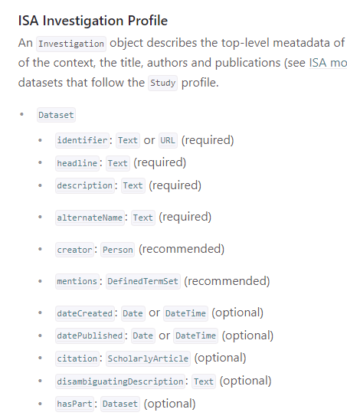
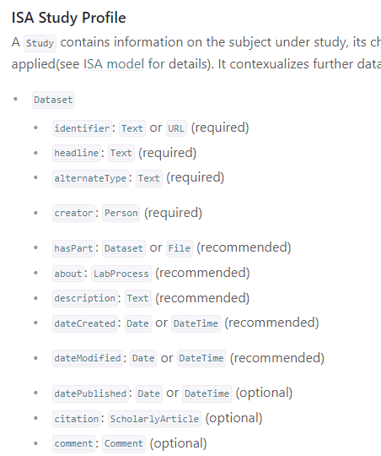
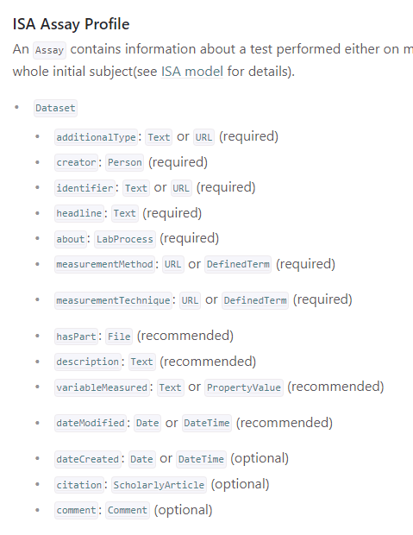
ARC RO-Crate

Slide 27
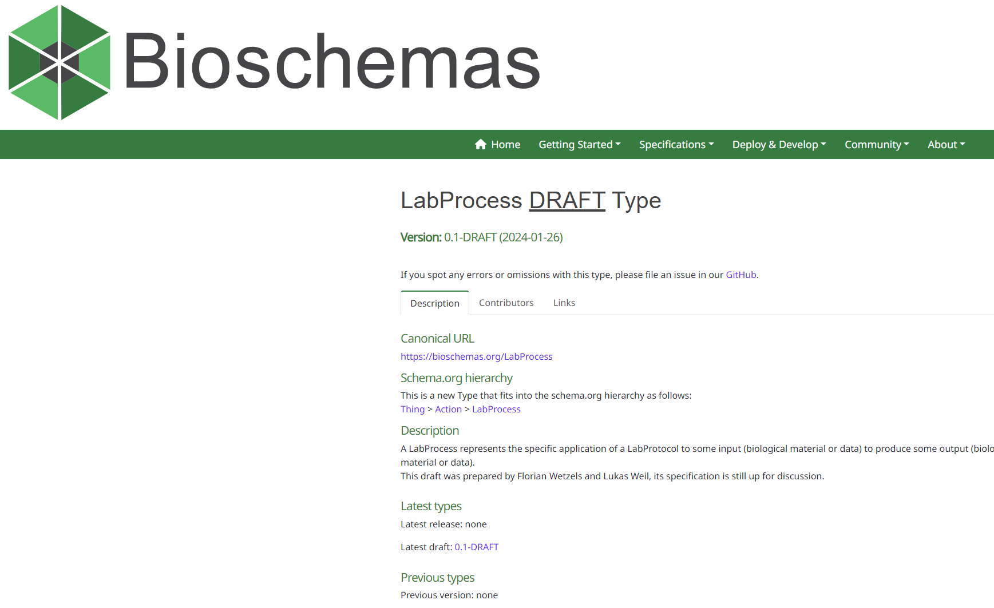

Slide 28
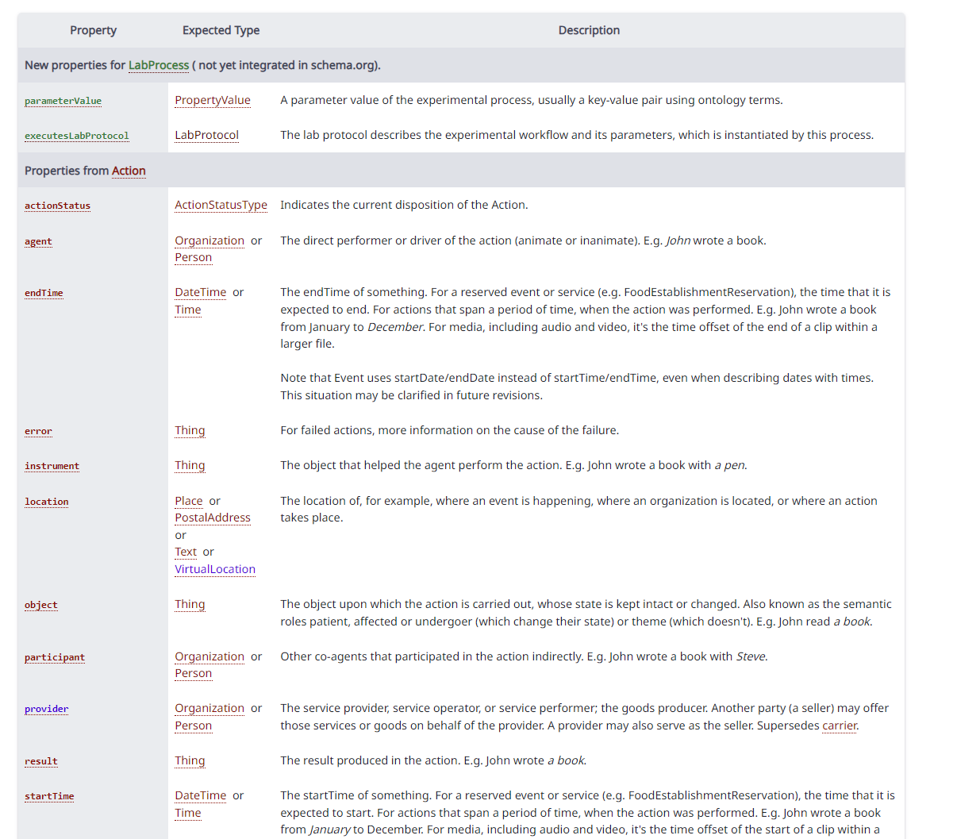
LabProcess properties
…
…
…

Slide 29

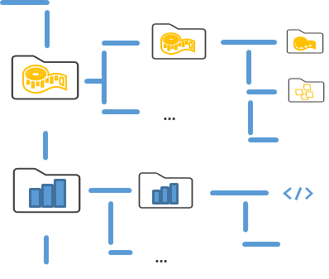
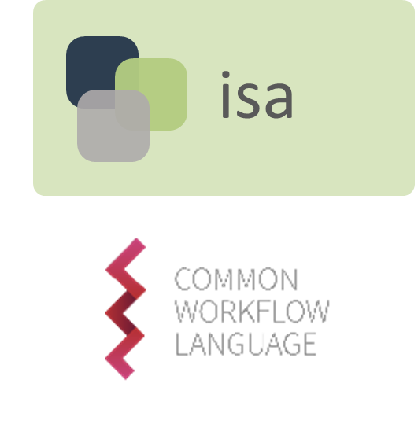
What is an ARC user perspective?
+
+

Slide 30
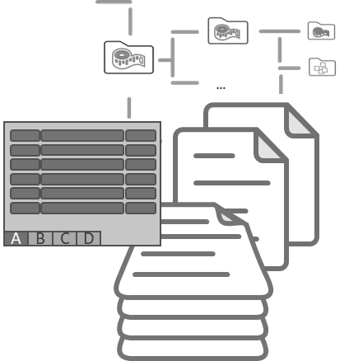
ARC representations: Two sides of the same coin
{JSON-LD}
A
B
C
D
ZIP
*optional
File system representation with tabular data as intuitive user interface
BUT: same underlying knowledge graph

Slide 31




Immutable yet Evolving
F
restore
FA
FAI
versions
FAIR
collaborate
Our approach supports the real-world process towards FAIR
heiBooks 2021 https://doi.org/10.11588/heibooks.979.c13751
Notes:
Data is never finished

Slide 32

ARCs means complete authority of data
DataPLANT
local project
ARCs start local
ARC services exit also as on-premise option

Slide 33
ARCs means complete authority of data
DataPLANT
local project
on-premise
ARCs start local
ARC services exit also as on-premise option

Slide 34
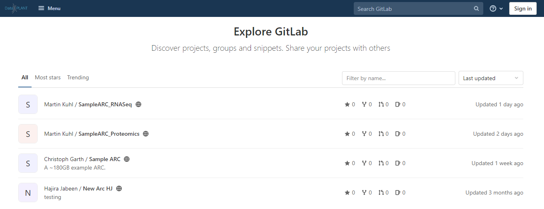
Find ARCs in the ARC registry
Explore DataPLANT

Slide 35
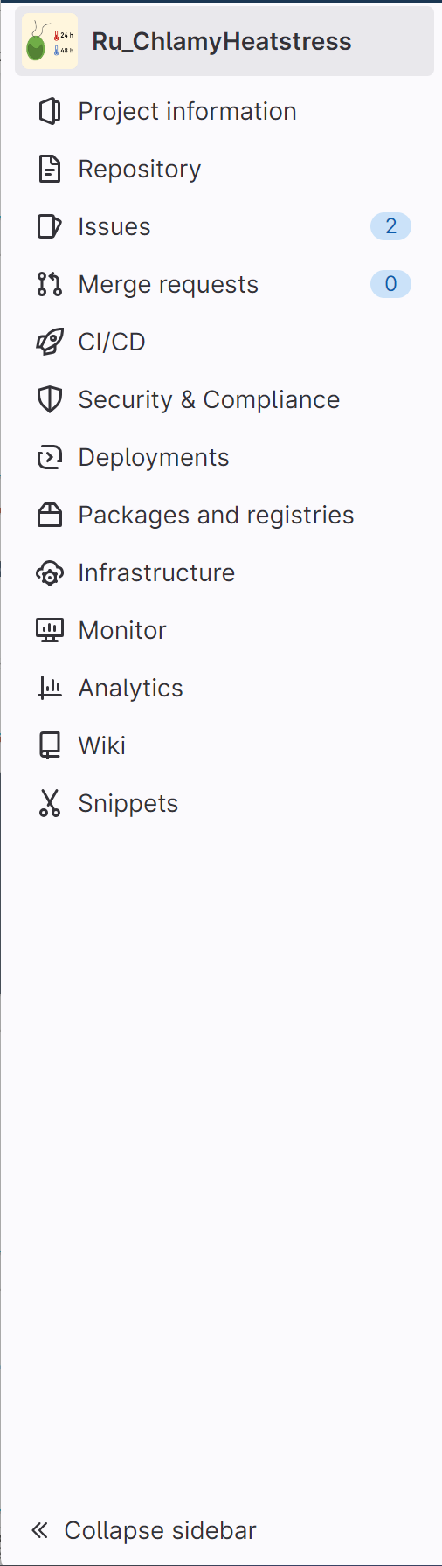
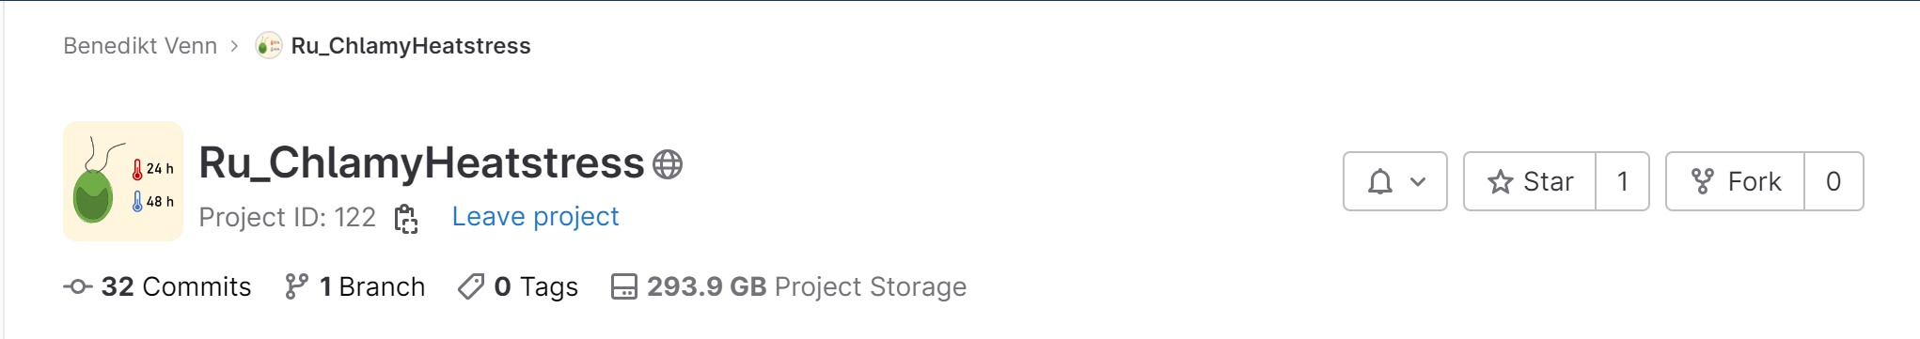

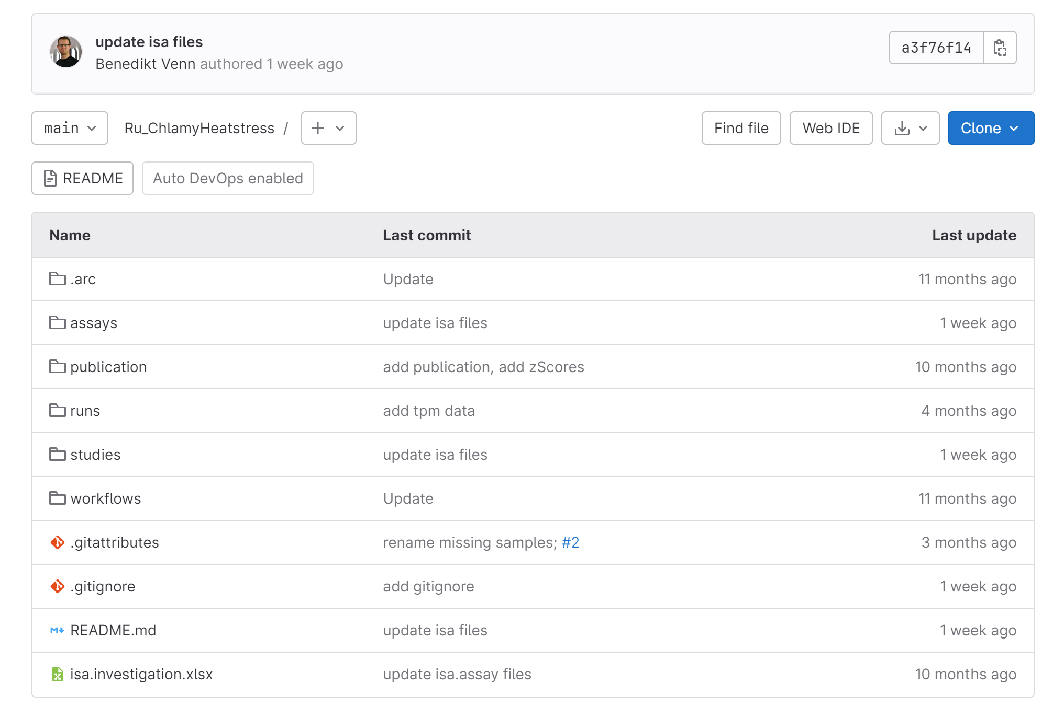
ARCs allow structured collaborative research
(even across disciplines)

Slide 36
Continuous integration
build
test
check-in
result
result

Slide 37
ARCs allow structured collaborative research
(even across disciplines)

Slide 38
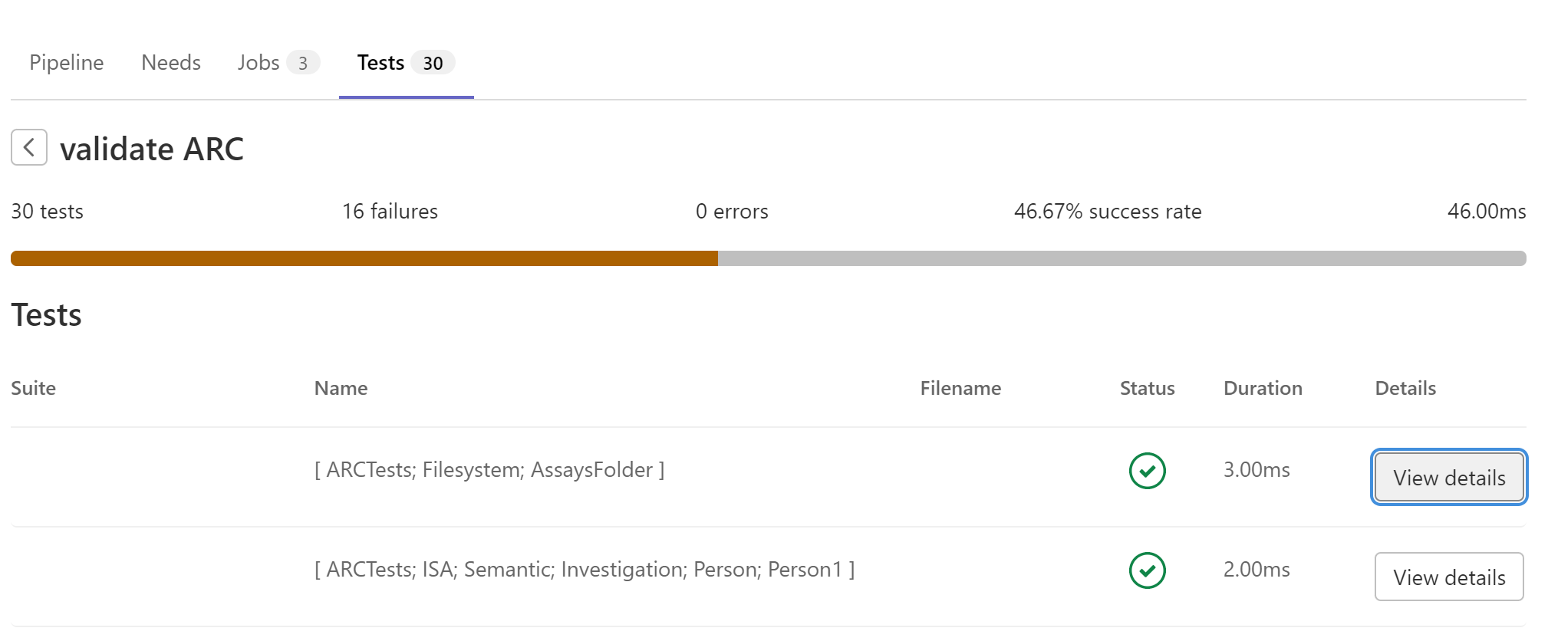

Slide 39
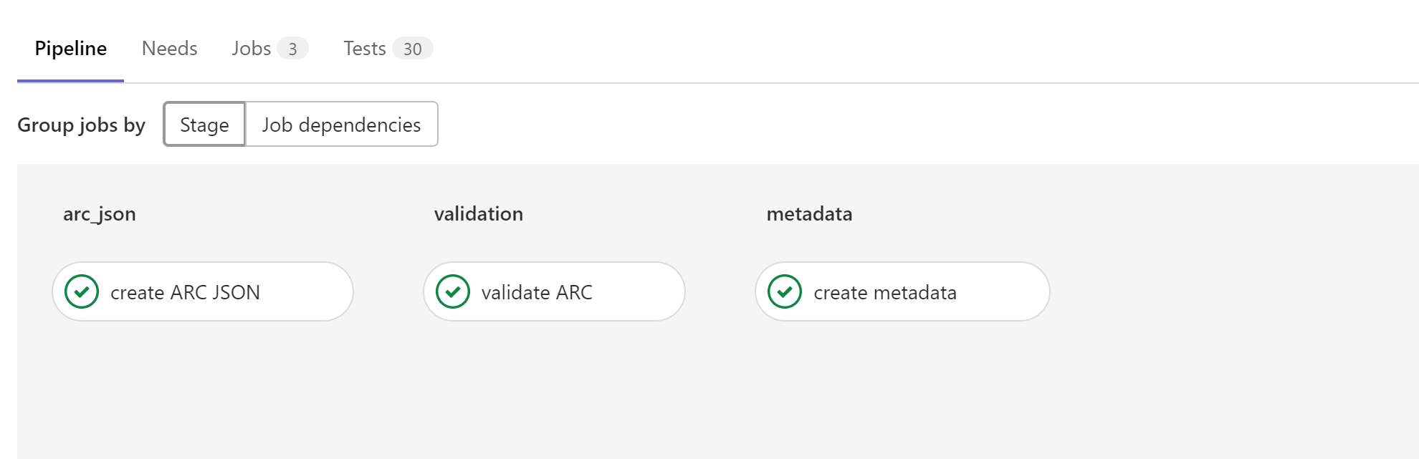

Slide 40
ARCs can be published seamlessly

Slide 41


ARCs can be published seamlessly
tools
write
read
dataset search
ISA-Tab
*
edit
CWL
RO-Crate
ARC
*
*post-commit
data publication

Slide 42
Instrument
Manufacturer: “Corp Corp”
Setting1: “10cm”
Setting2: “5/7”
DataInfo
Format: “Tabular”
MeasuredWith:
Data
Name: “File.csv”
Factor: “Chemical1”
DataInfo:
MeasuredFrom:
Provenance:
Sample
Name: “MySample”
Organism:
Organism
Genus: “Arabidopsis”
Species: “Arabidopsis thaliana”
Person
Name: “Mr. Dude”
Company:
Role: “Doer”
Company
Name: “MyUni”
Address: “Good Road”

Slide 43
Person
Name: “Mr. Dude”
Company:
Role: “Doer”
Company
Name: “MyUni”
Address: “Good Road”
Source
Name: “MySource”
Sample
Name: “MySample”
Data
Name: “File.csv”
Sample Preparation
Measurement
Genus: “Arabidopsis”
Factor: “Chemical1”
Manufacturer: “Corp Corp”
Format: “Tabular”
Setting2: “5/7”
Species: “Arabidopsis”
Setting1: “10cm”

Slide 44
Designing a model for shared knowledge
Two approaches:
Datamodel approach: Types contain domain specific properties which agents in this domain might expect
Ontology approach: Types contain properties allowing referencing external domain specific concepts. The ontological relationships between the concepts apply to our entities

Slide 45
Domain specificity
Both datamodel and ontology approach allowed
Datamodel approach: Inputs and outputs of processes and references to used components may be designed at will
Ontology approach: Inputs and outputs of processes and the processes themselves can be annotated using characteristics and parameters

Slide 46
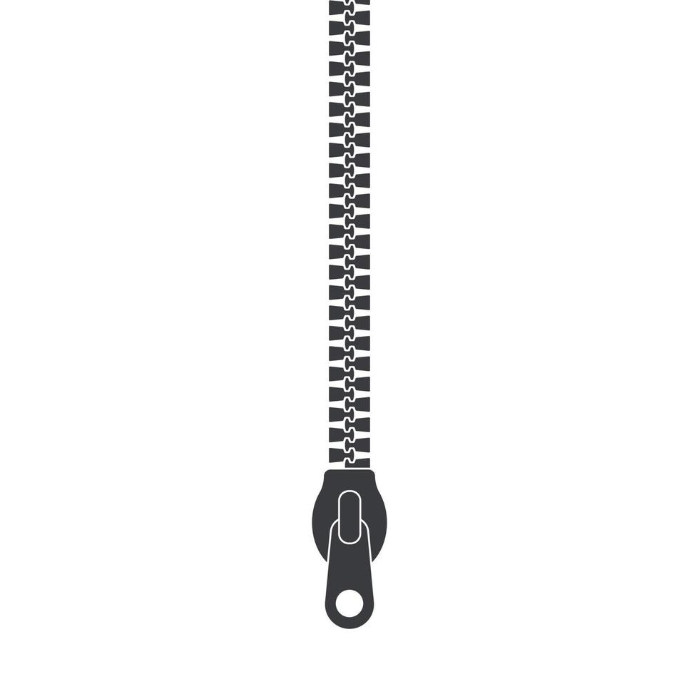
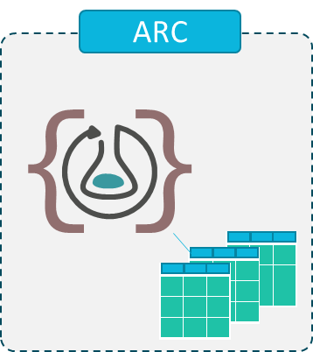

RO-Crate and ARC
Dataset
ARC
Dataset
LabProcess
LabProtocol
…
zip
git versioning
Persistence and identity is ensured by ARC – versioning system (Git)
Notes:
To increase interoperability and decentralized working capabilities, we use a persistent versioning based on git. Because of this, an ARC can evolve in parallel, but still be comparable and mergeable.

Slide 47
ARCtrl Data model and contract workflow
Kevin Frey

Slide 48
ARCtrl
Motivation
We are an open-source community. We want to provide low entry barrier options for contribution.
ARCtrl must be the unambiguous linker between different representations of the data model. (JSON, table, process).
ARCtrl must guarantee correct operations done on the ARC information following specifications.
ARCtrl must offer key operations performed on the ARC (e.g. CRUD).

Slide 49
ARC representations: Two sides of the same coin
{JSON-LD}
ARCtrl
A
B
C
D
ZIP
*optional
ARCtrl is the unambiguous linker between ARC and tooling

Slide 50



ARC as ground truth for users and tools
ground-truth
<study1>
resources
…
protocols
studies
<assay1>
dataset
assays
…
protocols
workflows
<workflow1>
script / code / …
user
…
CWL
specializes data-views
runs
<run1>
data files
datamodel
…
CWL
investigation
user view
tooling
ARC needs to be user-friendly towards the user and machine-friendly towards tools
Notes:
why though (Spezifikation?)->

Slide 51
ARC flexibility
Information is split up in multiple files
Metadata and data file registration is handled in investigation
Studies and Assays are normalized to ARC root
Result file access
<study1>
resources
…
protocols
studies
<assay1>
dataset
assays
…
protocols
workflows
<workflow1>
script / code / …
…
CWL
runs
<run1>
data files
…
CWL
investigation

Slide 52

XLSX dialect
Namespaces are sometimes used
Table linking can be done in different places
Cell formatting can be performed in different ways
Text and Value storage might be centralized

Slide 53
ARCtrl
ARCtrl
<study1>
resources
…
protocols
studies
<assay1>
dataset
assays
…
protocols
workflows
<workflow1>
script / code / …
…
CWL
user
runs
<run1>
data files
specializes data-views
datamodel
…
CWL
investigation
ground-truth
user view
ARCtrl is the unambiguous linker between ARC and tooling
Notes:
why though (Spezifikation?)->

Slide 54





Program layers
user
Interaction Layer
Business Logic
ARCtrl
Contract Layer
Tool
Data Access
Data
Core ARC operations are implemented in ARCtrl
The implementing tool adds its flavour by providing specialized interaction and data access layer

Slide 55
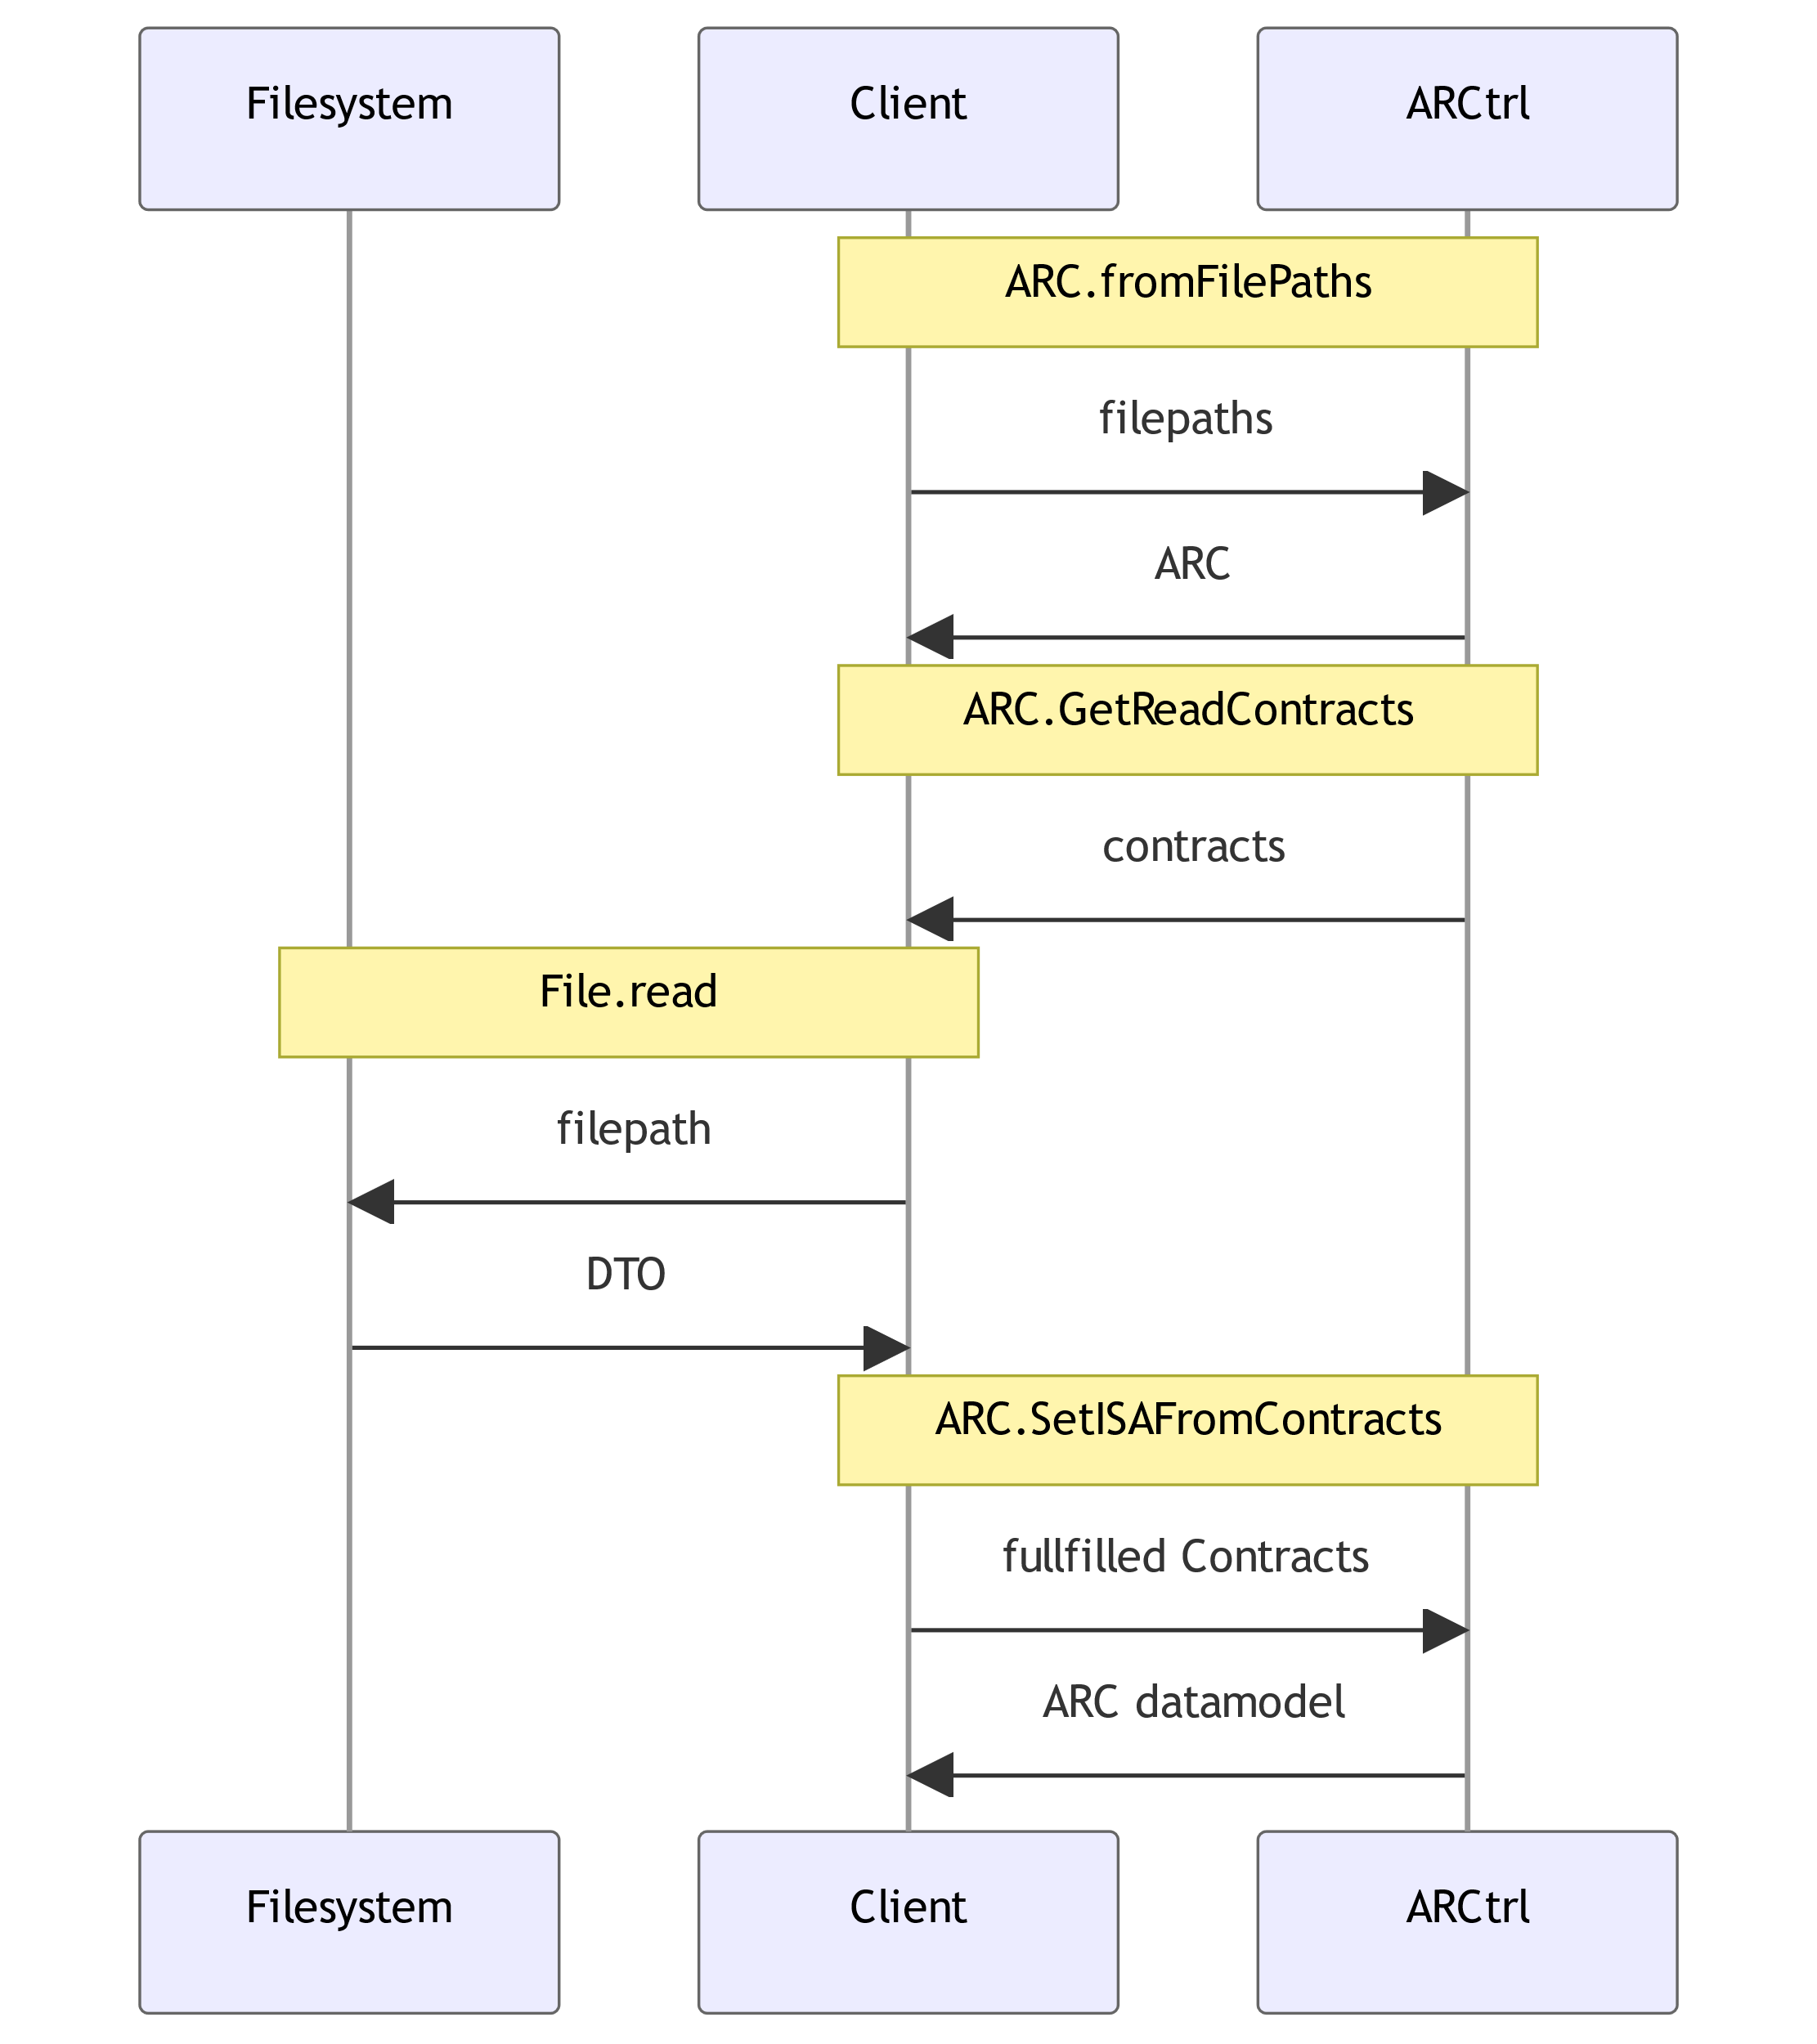
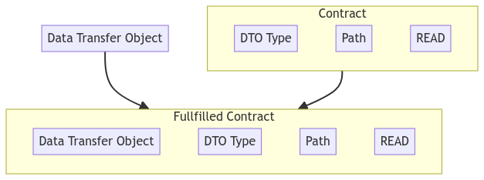
Contract workflow

Slide 56

ISA process ambiguity
Protocol and Process mapping to Table
Characteristics might be associated to input or output

Slide 57
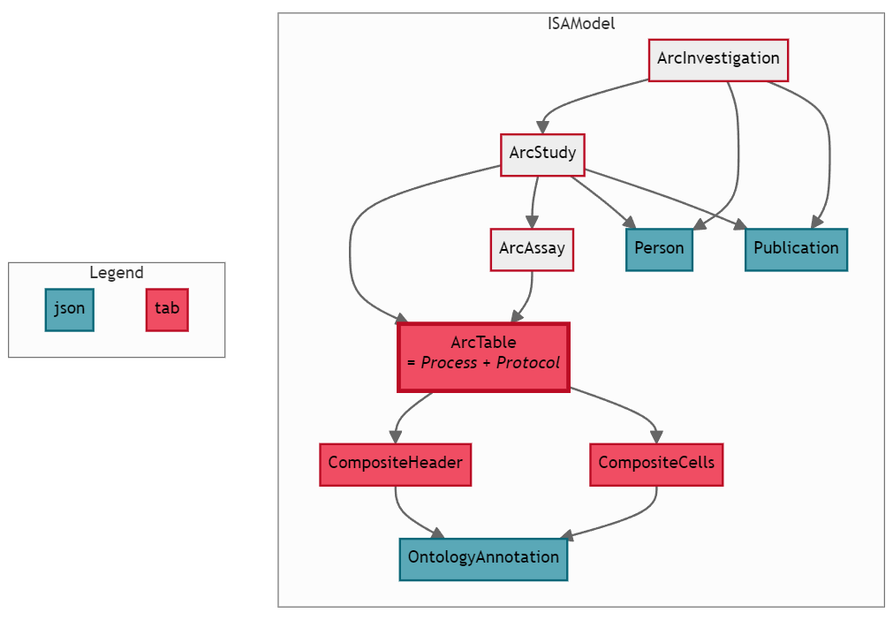
Process representation

Slide 58
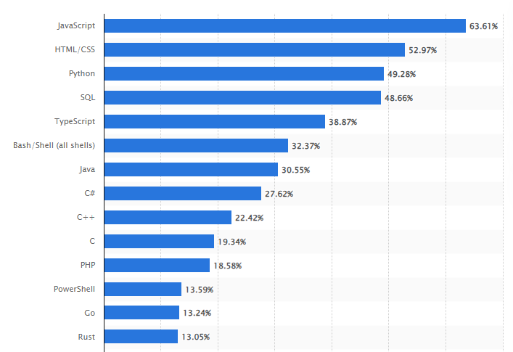
Implementation Questions
What language should be used?
Support multiple languages?
How to minimize code duplication?
How to maximize test coverage?
Most used programming languages among developers worldwide as of 2023. From statista.

Slide 59





Fable Transpilation
One codebase in F#
Minimal code duplication.
Tests transpiled for Python and JavaScript.
F# - .NET
F# - Transpiler
What is F#?
Lightweight syntax
First-class functions and rich object support
Rich data types and strong type safety
Powerful pattern matching for complex behaviour
JavaScript

Slide 60
Fable Transpilation
let x = "Hello World"
SynBinding.SynBinding(
accessibility = None,
kind = SynBindingKind.Normal,
isInline = false,
isMutable = false,
attributes = [],
headPat =
SynPat.Named(ident = SynIdent.SynIdent(ident = Ident("x", R("(1,4--1,5)"))), range = R("(1,4--1,5)"))
expr =
SynExpr.Const(constant = SynConst.String(text = "Hello World", synStringKind = SynStringKind.Regular, range = R("(1,8--1,21)")), range = R("(1,8--1,21)"))
)
Reads Abstract Syntax Tree (AST) and creates other language from it.

Slide 61
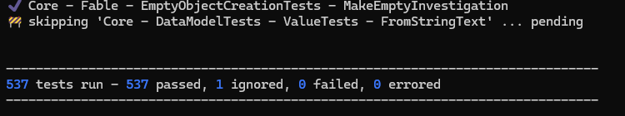
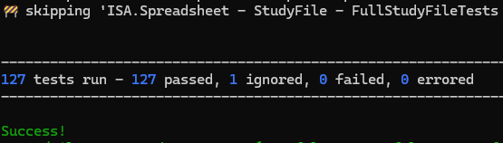
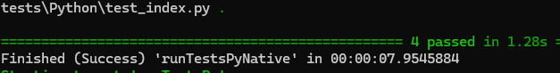
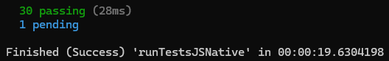
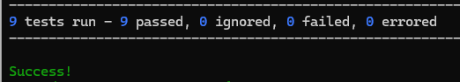
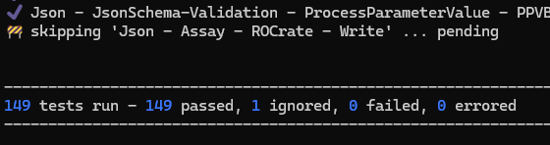
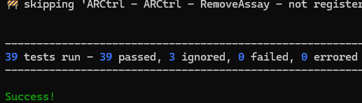
Fable Transpilation
close to
900
Tests

Slide 62
JavaScript transpilation
let myInvestigation = ArcInvestigation("BestInvestigation")
let myStudy = myInvestigation.InitStudy("BestStudy")
let growth = ArcTable.init("Growth") let oa_species =
OntologyAnnotation(
"species", "GO", "GO:0123456"
)
let oa_chlamy =
OntologyAnnotation(
"Chlamy", "NCBI", "NCBI:0123456"
)
growth.AddColumn(
CompositeHeader.Input IOType.Source,
[|CompositeCell.FreeText "Input1"|]
)
growth.AddColumn(
CompositeHeader.Characteristic oa_species,
[|CompositeCell.Term oa_chlamy|]
)
myStudy.AddTable(growth)
let myInvestigation = new ArcInvestigation("BestInvestigation");
let myStudy = myInvestigation.InitStudy("BestStudy");
let growth = ArcTable.init("Growth");
let oa_species =
new OntologyAnnotation(
"species", "GO", "GO:0123456"
);
let oa_chlamy =
new OntologyAnnotation(
"Chlamy", "NCBI", "NCBI:0123456"
);
growth.AddColumn(
CompositeHeader.input(IOType.source()),
[CompositeCell.freeText("Input1")]
);
growth.AddColumn(
CompositeHeader.characteristic(oa_species),
[CompositeCell.term(oa_chlamy)]
);
myStudy.AddTable(growth);
F#
JS

Slide 63
Python transpilation
let myInvestigation = ArcInvestigation("BestInvestigation")
let myStudy = myInvestigation.InitStudy("BestStudy")
let growth = ArcTable.init("Growth") let oa_species =
OntologyAnnotation(
"species", "GO", "GO:0123456"
)
let oa_chlamy =
OntologyAnnotation(
"Chlamy", "NCBI", "NCBI:0123456"
)
growth.AddColumn(
CompositeHeader.Input IOType.Source,
[|CompositeCell.FreeText "Input1"|]
)
growth.AddColumn(
CompositeHeader.Characteristic oa_species,
[|CompositeCell.Term oa_chlamy|]
)
myStudy.AddTable(growth)
my_investigation = ArcInvestigation("BestInvestigation")
my_study: ArcStudy = my_investigation.InitStudy("BestStudy")
growth: ArcTable = ArcTable.init("Growth")
oa_species: OntologyAnnotation =
OntologyAnnotation(
"species", "GO", "GO:0123456„
)
oa_chlamy: OntologyAnnotation =
OntologyAnnotation(
"Chlamy", "NCBI", "NCBI:0123456"
)
growth.AddColumn(
CompositeHeader.input(IOType.source()),
[CompositeCell.free_text("Input1")]
) growth.AddColumn(
CompositeHeader(1, oa_species),
[CompositeCell.create_term(oa_chlamy)]
)
my_study.AddTable(growth)
F#
Py
Collaboration wanted for python transpilation

Slide 64
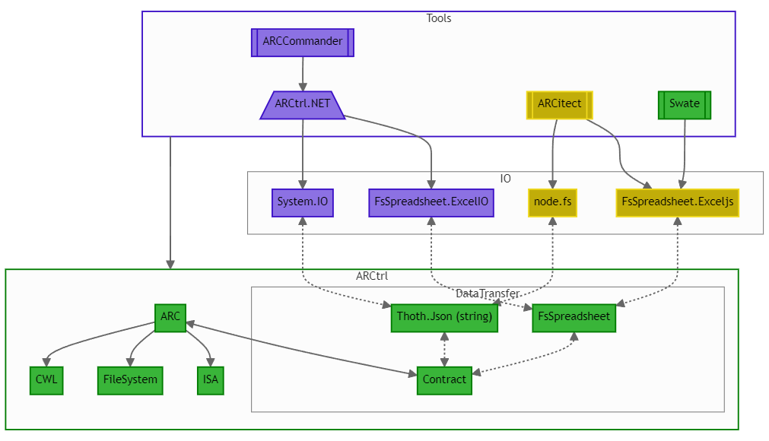
Program layers

Slide 65


Different flavours of access
user
ARCtrl
<study1>
resources
studies
…
protocols
<assay1>
dataset
assays
…
protocols
workflows
<workflow1>
script / code / …
…
CWL
runs
<run1>
data files
…
CWL
user
ARCitect
investigation
arc-export
ARCCommander 1.0.0
ARCitect 0.0.21
arc-to-invenio
arc-export

Slide 66



Thank you for your attention

